Slide 1

Continuous Monitoring of Pareto Frontiers over Partially Ordered Attributes for Many Users
Afroza Sultana and Chengkai Li
Innovative Database and Information Systems Research Lab
The University of Texas at Arlington
EDBT 2018, Vienna, Austria
Notes:
Hi, I’m Afroza Sultana; going to present our paper.
This is a join work with my supervisor Dr. Chengkai Li.
Let’s come to the motivation behind this work.

Slide 2



Motivation
Recommendation based on users' preferences
2
System idir.uta.edu/claimbuster
System idir.uta.edu/claimbuster
Notes:
Many real world applications recommend objects based on users' preferences.
For instance, online vendors analyze users’ behavior for product recommendation.
Social networks ask for users’ feedback in order to improve content selection.

Slide 3
Motivation
Recommendation based on users' preferences
Preferences with multiple attributes
I prefer 16″ to 14″ display.
3
System idir.uta.edu/claimbuster
System idir.uta.edu/claimbuster
System idir.uta.edu/claimbuster
System idir.uta.edu/claimbuster
Notes:
People have different preferences while picking an object with multiple attributes.
For instance, customers choose laptop based on their preferences over brand, display and CPU.

Slide 4

Motivation
Recommendation based on users' preferences
Preferences with multiple attributes
Goal: objects that ″stand out″
I prefer 16″ to 14″ display.
4
System idir.uta.edu/claimbuster
System idir.uta.edu/claimbuster
System idir.uta.edu/claimbuster
System idir.uta.edu/claimbuster
Notes:
Upon the arrival of a new object, we aim at monitoring the “stand out” objects for each user.
Let’s relate this with database.

Slide 5
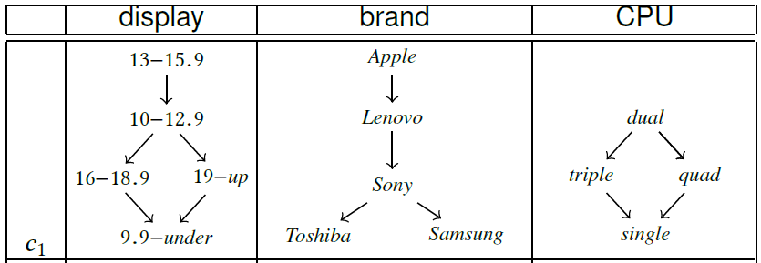
An Example
 | display | brand | CPU
o₁ | 12 | Apple | single
o₂ | 14 | Apple | dual
… | ... | ... | ...
o₇ | 16.5 | Lenovo | quad
5
System idir.uta.edu/claimbuster
System idir.uta.edu/claimbuster
Notes:
Consider an inventory of laptops and customers' preferences on individual attributes modeled as strict partial orders.
The right table is an append-only object table. The left table describes the preferences of a customer c1 in terms of display, brand and CPU. The strict partial orders on these attributes together represents the customer's preferences on objects.

Slide 6
An Example
 | display | brand | CPU
o₁ | 12 | Apple | single
o₂ | 14 | Apple | dual
… | ... | ... | ...
o₇ | 16.5 | Lenovo | quad
6
System idir.uta.edu/claimbuster
System idir.uta.edu/claimbuster
Notes:
Here o2 is not preferred over by any other object as its each attribute value appears on the topmost position of the corresponding partial order. The objects that are not preferred over by any other object are called Pareto-optimal objects or Pareto frontier. We assume those as “stand out” objects. Therefore, o2 belongs to the Pareto frontier and considered as a “stand out” object.

Slide 7
An Example
 | display | brand | CPU
o₁ | 12 | Apple | single
o₂ | 14 | Apple | dual
… | ... | ... | ...
o₇ | 16.5 | Lenovo | quad
7
System idir.uta.edu/claimbuster
System idir.uta.edu/claimbuster
Notes:
Let’s compare o7 with o2. For display, c1 prefers 14 inches to 16.5 inches; for brand, c1 prefers Apple to Lenovo; for CPU, c1 prefers dual to quad core. Therefore, c1 prefers o2 to o7 and o7 doesn’t belong to the Pareto frontier.

Slide 8
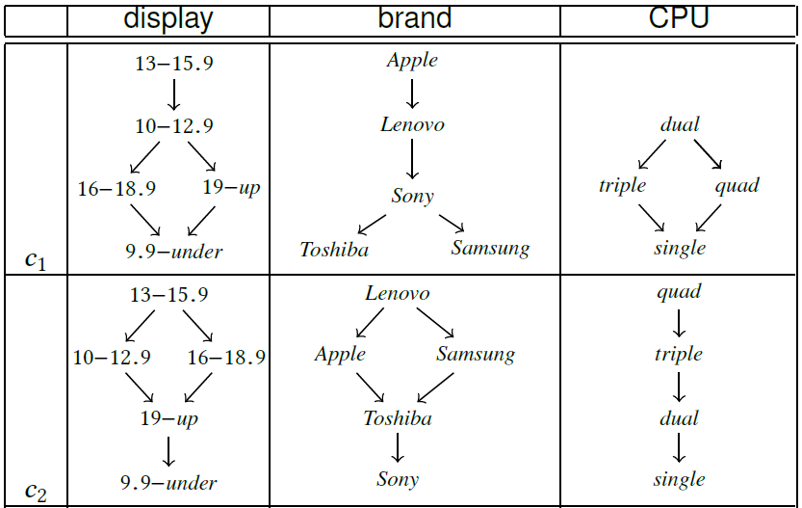
An Example
 | display | brand | CPU
o₁ | 12 | Apple | single
o₂ | 14 | Apple | dual
… | ... | ... | ...
o₇ | 16.5 | Lenovo | quad
8
System idir.uta.edu/claimbuster
System idir.uta.edu/claimbuster
Notes:
Consider another customer c2. In this case, for display, c2 prefers o2. However, in terms of brand and CPU, c2 prefers o7. In other words, c2 finds them incomparable.
If o7 is not preferred over by any other object in this table, it belongs to the Pareto frontier.

Slide 9
Problem Formulation
Set of attributes D
 | display | brand | CPU
o₁ | 12 | Apple | single
o₂ | 14 | Apple | dual
… | ... | ... | ...
o₇ | 16.5 | Lenovo | quad
Append-only object table O
Users′ preferences
9
System idir.uta.edu/claimbuster
System idir.uta.edu/claimbuster
Notes:
Let’s come to the problem formulation.
We have a set of users’ preferences and an append-only object table described by a set of attributes.

Slide 10
Problem Formulation
 | display | brand | CPU
o₁ | 12 | Apple | single
o₂ | 14 | Apple | dual
… | ... | ... | ...
o₇ | 16.5 | Lenovo | quad
Target users
Pareto frontier P_{c}
c₁
c₂
o₂
o₇
10
System idir.uta.edu/claimbuster
System idir.uta.edu/claimbuster
Notes:
This is the notation of Pareto frontier w.r.t a user. The users who nominate o in Pareto-optimality are called target users. For c1, the Pareto frontier contains only o2 while for c2 the Pareto frontier includes o7 as well. In other word, c2 is the only target user of o7.

Slide 11
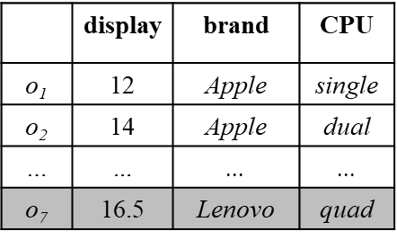
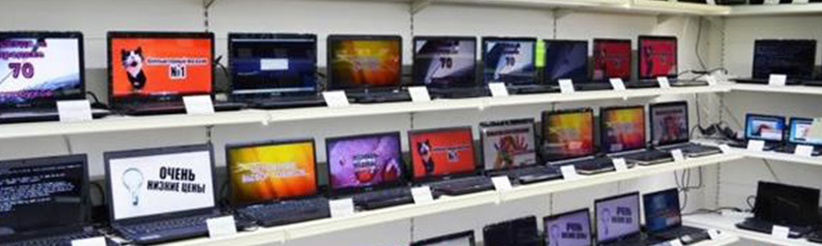
Problem Formulation; Continuous Object Dissemination
Find target users such that o₇ is in the Pareto frontier.
c₂
11
Notes:
Now given a set of users’ preferences on individual attributes and a new object appended to the object table, our Finding Target Users problem looks for users where it is a Pareto-optimal object.

Slide 12
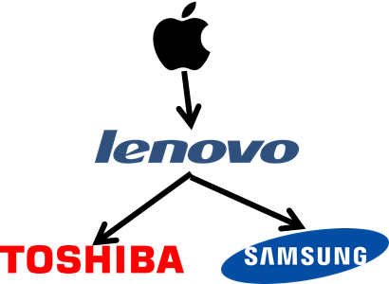
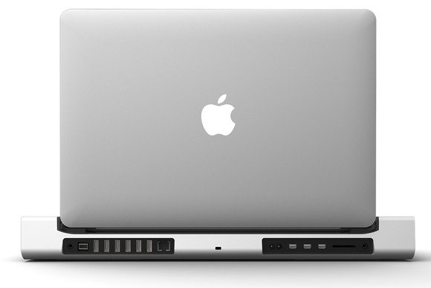


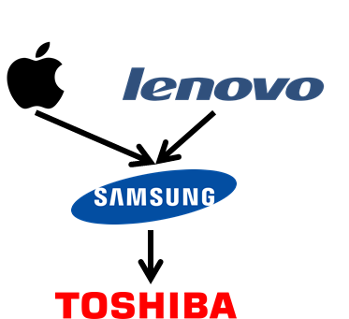


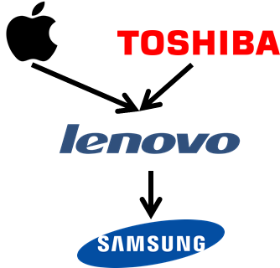


Challenges & Ideas
… … …
12
Notes:
Let’s come to the challenges. For simplicity, let’s consider single dimension.
In real world, there could be a number of users as well as objects streaming. And certainly, we have to disseminate an object on time.
The straight forward solution compares the new object under each user with every existing Pareto-optimal object, separately.
However, we observe that users’ Pareto-optimal objects could be similar.

Slide 13


Challenges & Ideas
13
Notes:
Let’s analyze these two users.
If user c prefers x to y, then (x,y) is a preference tuple of c.
Here, (Apple,Lenovo) is a preference tuple of the first user.

Slide 14


Challenges & Ideas
Preference tuples
14
Notes:
These are the all preference tuples of these two users.

Slide 15
Challenges & Ideas
✅
✅
✅
✅
✅
✅
✅
✅
Common preference tuples
15
Notes:
These blue check boxes indicates the common preference tuples of these two users.

Slide 16
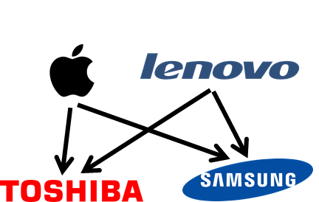
Challenges & Ideas
✅
✅
✅
✅
✅
✅
✅
✅
Common preference tuples
_{U}
16
Notes:
Here, U is a virtual user whose preferences consist of these common preference tuples. Because of this,

Slide 17
Challenges & Ideas
_{U}
17
Notes:
U’s Pareto frontier includes the Pareto frontiers of these two users.

Slide 18
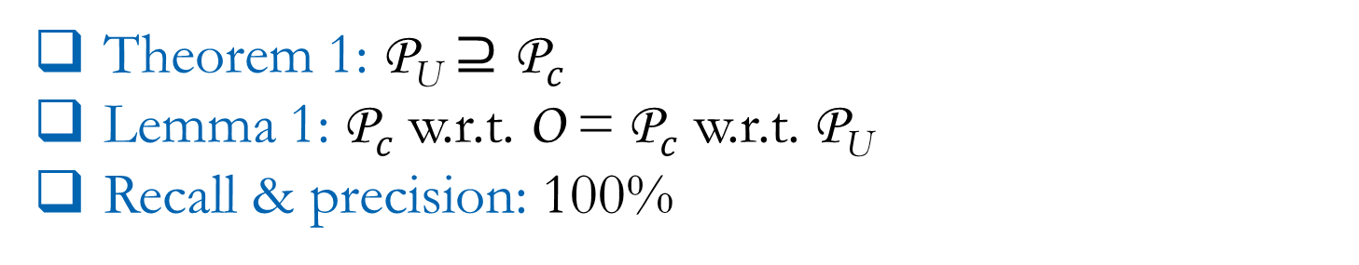

Challenges & Ideas
Theorem 1: P_{U} $⊇\text{P}c$
Lemma 1:$\text{P}c$ w.r.t. O = $\text{P}c$ w.r.t. P_{U}
Recall & precision: 100%
O
P_{U}
$$\text{P}c$$
Sharing computation across users
18
Notes:
This Venn diagram shows the relation between the Pareto frontier of U and the Pareto frontier of a corresponding user.
We can see that the larger circle includes the smaller one. That means, the Pareto frontier of U is the superset of the Pareto frontier of c.
Therefore, if we consider only the Pareto frontier of U or this outer circle rather all objects in the table, the resulting Pareto frontier of c would remain the same.
In other words, there is no loss of accuracy.
Therefore, to resolve the exhaustive comparison for every users with each Pareto-optimal object, our idea is sharing computation across users.

Slide 19
Challenge and Ideas
Which users share preferences?
Cluster users based on preferences
No prior study on clustering for partial orders
Study clustering partial orders
19
System idir.uta.edu/claimbuster
System idir.uta.edu/claimbuster
Notes:
Now the new challenge is finding users having similar preferences. We cluster users based on preferences.
As the users’ preferences are described as strict partial orders and there is no prior study on clustering for partial orders, we study the novel problem of clustering strict partial orders.

Slide 20
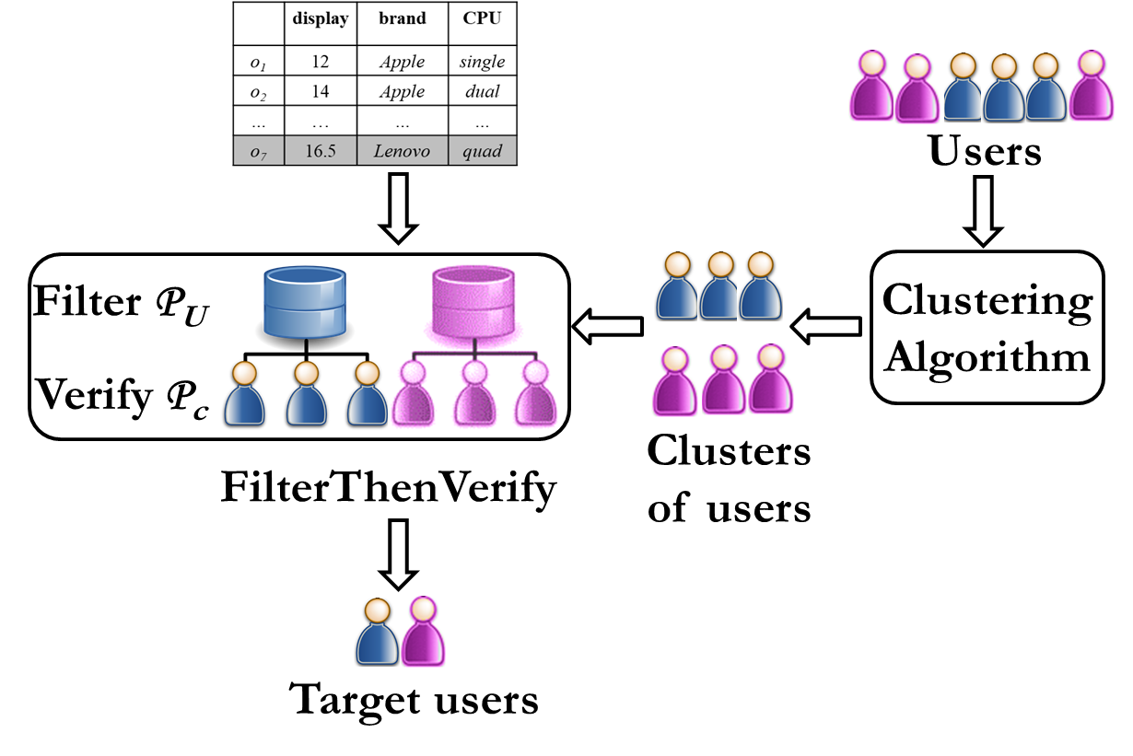
System Architecture
20
System idir.uta.edu/claimbuster
System idir.uta.edu/claimbuster
Notes:
This is our system architecture.
Given a set of users, we first cluster them. Here we can see two clusters of users. Upon the arrival of a new object, our algorithm FilterThenVerify finds target users.
Let’s look through FilterThenVerify in detail.

Slide 21
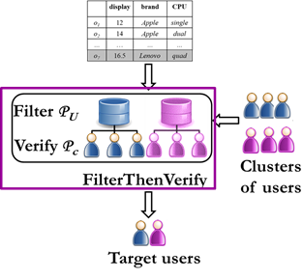
FilterThenVerify
For each cluster in C
Filter: if U approve o in Pareto-optimality, stores o in P_{U}
Verify: for each c, determines whether o belongs to P_{c}
21
System idir.uta.edu/claimbuster
System idir.uta.edu/claimbuster
Notes:
We propose this algorithm based on sharing computation across users.
The first step is filtering. Upon the arrival of a new object, the algorithm first computes the Pareto frontier for the common preference tuples of each cluster.
If this filtering approves o in Pareto-optimality, then for each user, o is further verified whether it belongs to the corresponding Pareto frontier.

Slide 22
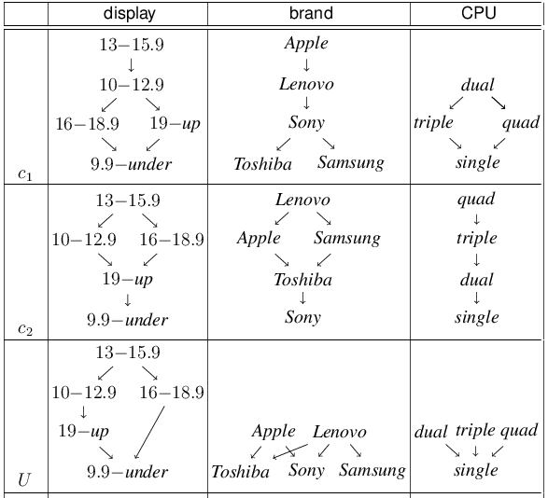
FilterThenVerify
 | display | brand | CPU
o₁ | 12 | Apple | single
o₂ | 14 | Apple | dual
o₃ | 15 | Samsung | dual
o₄ | 19 | Toshiba | quad
o₅ | 9 | Samsung | quad
o₆ | 9.5 | Lenovo | triple
o₇ | 16.5 | Lenovo | quad
22
Notes:
Let’s look through an example.
Here, the virtual user U has the common preferences of the customers c1 and c2.

Slide 23
FilterThenVerify
 | display | brand | CPU
o₁ | 12 | Apple | single
o₂ | 14 | Apple | dual
o₃ | 15 | Samsung | dual
o₄ | 19 | Toshiba | quad
o₅ | 9 | Samsung | quad
o₆ | 9.5 | Lenovo | triple
o₇ | 16.5 | Lenovo | quad
Filter
P_{U} ={o₂,o₃,o₆}
Verify
P_{c1} ={o₂}
Verify
P_{c2} ={o₂,o₃}
23
System idir.uta.edu/claimbuster
System idir.uta.edu/claimbuster
Notes:
This is the picture of FilterThenVerify before the arrival of o7.

Slide 24
FilterThenVerify
 | display | brand | CPU
o₁ | 12 | Apple | single
o₂ | 14 | Apple | dual
o₃ | 15 | Samsung | dual
o₄ | 19 | Toshiba | quad
o₅ | 9 | Samsung | quad
o₆ | 9.5 | Lenovo | triple
o₇ | 16.5 | Lenovo | quad
Filter
P_{U} ={o₂,o₃,o₆}
Verify
P_{c1} ={o₂}
Verify
P_{c2} ={o₂,o₃}
24
System idir.uta.edu/claimbuster
System idir.uta.edu/claimbuster
Notes:
Upon the arrival of o7, the algorithm first proceeds through filtering. As o7 is not dominated by any of these three objects, the Pareto frontier includes it.

Slide 25
FilterThenVerify
 | display | brand | CPU
o₁ | 12 | Apple | single
o₂ | 14 | Apple | dual
o₃ | 15 | Samsung | dual
o₄ | 19 | Toshiba | quad
o₅ | 9 | Samsung | quad
o₆ | 9.5 | Lenovo | triple
o₇ | 16.5 | Lenovo | quad
Filter
P_{U} ={o₂,o₃,o₆,o₇}
Verify
P_{c1} ={o₂}
Verify
P_{c2} ={o₂,o₃}
25
System idir.uta.edu/claimbuster
System idir.uta.edu/claimbuster
Notes:
Now the algorithm enters to the verification step.

Slide 26
FilterThenVerify
 | display | brand | CPU
o₁ | 12 | Apple | single
o₂ | 14 | Apple | dual
o₃ | 15 | Samsung | dual
o₄ | 19 | Toshiba | quad
o₅ | 9 | Samsung | quad
o₆ | 9.5 | Lenovo | triple
o₇ | 16.5 | Lenovo | quad
Filter
P_{U} ={o₂,o₃,o₆,o₇}
Verify
P_{c1} ={o₂}
Verify
P_{c2} ={o₂,o₃}
26
System idir.uta.edu/claimbuster
System idir.uta.edu/claimbuster
Notes:
Since c1 prefers o2 to o7, o7 doesn’t belong to the Pareto frontier.

Slide 27
FilterThenVerify
 | display | brand | CPU
o₁ | 12 | Apple | single
o₂ | 14 | Apple | dual
o₃ | 15 | Samsung | dual
o₄ | 19 | Toshiba | quad
o₅ | 9 | Samsung | quad
o₆ | 9.5 | Lenovo | triple
o₇ | 16.5 | Lenovo | quad
Filter
P_{U} ={o₂,o₃,o₆,o₇}
Verify
P_{c1} ={o₂}
Verify
P_{c2} ={o₂,o₃}
27
System idir.uta.edu/claimbuster
System idir.uta.edu/claimbuster
Notes:
However, as w.r.t. c2, o7 is not preferred over by any of these existing Pareto-optimal objects,

Slide 28
FilterThenVerify
 | display | brand | CPU
o₁ | 12 | Apple | single
o₂ | 14 | Apple | dual
o₃ | 15 | Samsung | dual
o₄ | 19 | Toshiba | quad
o₅ | 9 | Samsung | quad
o₆ | 9.5 | Lenovo | triple
o₇ | 16.5 | Lenovo | quad
Filter
P_{U} ={o₂,o₃,o₆,o₇}
Verify
P_{c1} ={o₂}
Verify
P_{c2} ={o₂,o₃,o₇}
28
System idir.uta.edu/claimbuster
System idir.uta.edu/claimbuster
Notes:
the Pareto frontier includes it.
In real world, acquiring Pareto-optimality is very competitive. Therefore, most of the objects are filtered out and no further verification is needed. Thus FilterThenVerify resolves computation overhead.

Slide 29
System Architecture
29
System idir.uta.edu/claimbuster
System idir.uta.edu/claimbuster
Notes:
Now let’s look through the clustering. As the users’ preferences are described as strict partial orders and there is no prior study on clustering for partial orders, we define similarity functions for partial orders.

Slide 30
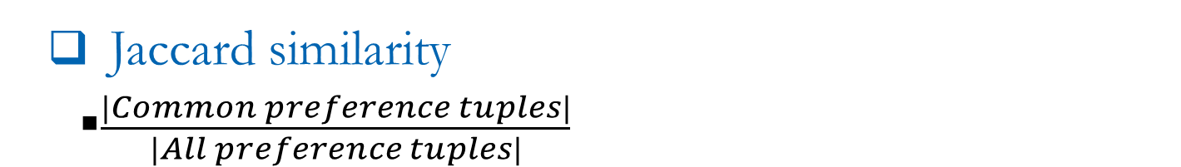
Similarity Function
✅
✅
✅
✅
✅
✅
✅
✅
Common preference tuples
Jaccard similarity
$\frac{|Common preference tuples|}{|All preference tuples|}$
30
System idir.uta.edu/claimbuster
System idir.uta.edu/claimbuster
Notes:
We define Jaccard similarity as the ratio of common preference tuples to all preference tuples in two clusters.
As both of the users have 4 common preference tuples and they have 6 preference tuples in total; the Jaccard similarity is 4/6.

Slide 31
Similarity Function
✅
✅
✅
✅
✅
✅
✅
✅
Common preference tuples
Weighted Jaccard similarity
Locations of preference tuples
31
System idir.uta.edu/claimbuster
System idir.uta.edu/claimbuster
Notes:
However, we observe that the impact of a preference tuple varies with its location in the partial order. Intuitively, though both of the users prefer Lenovo to Samsung, since Lenovo is one of the topmost value of the 2nd user, the preference “Lenovo to Samsung” has more impact on her rather than the first user.
We further define weighted Jaccard similarity as the ratio of intersection size to union size while the weights of the preference tuples are considered.

Slide 32
Approx. Common Preference Tuples
Preferences can be diverse
Tiny clusters
32
System idir.uta.edu/claimbuster
System idir.uta.edu/claimbuster
Notes:
Now preferences can be diverse which may lead tiny clusters.

Slide 33
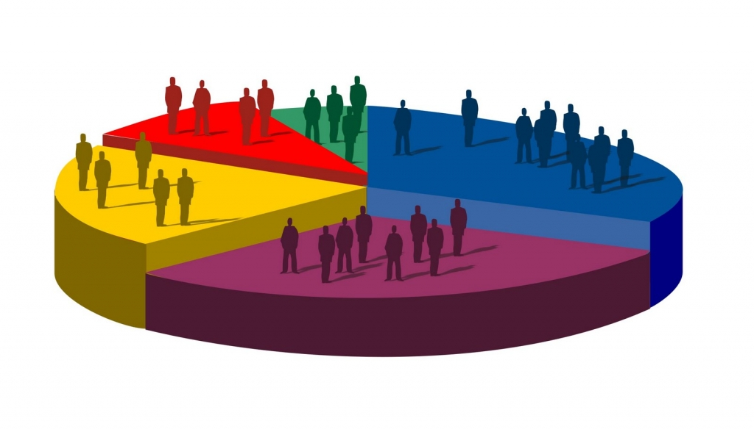
Approx. Common Preference Tuples
Preferences can be diverse
Tiny clusters
Relax idea of common preference tuple
Preference polling
33
System idir.uta.edu/claimbuster
System idir.uta.edu/claimbuster
Notes:
To resolve this issue, we relax the idea of common preference tuple.
We consider a preference tuple as an approx. common preference tuple, if sufficient number of users in a cluster agree on it.

Slide 34
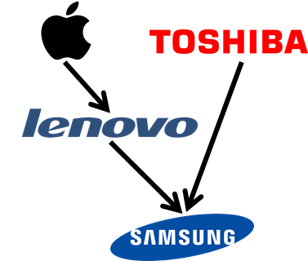
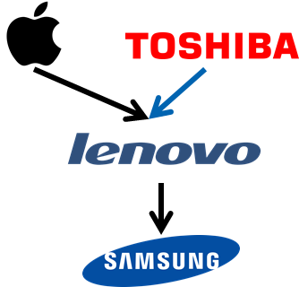
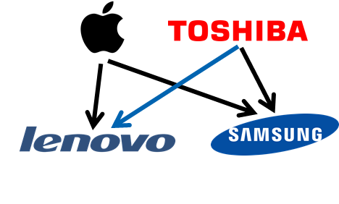
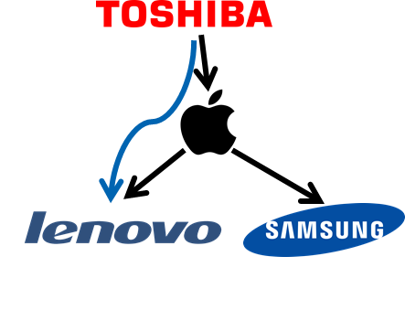
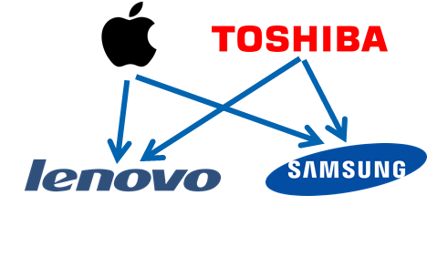
GetApproxCommonPreferenceTuples
34
Notes:
Given these four users’ preference on brand, this represents approximate preference tuples.
Along with the common preference tuples, it contains (Toshiba,Lenovo) which presents in 75% users.

Slide 35



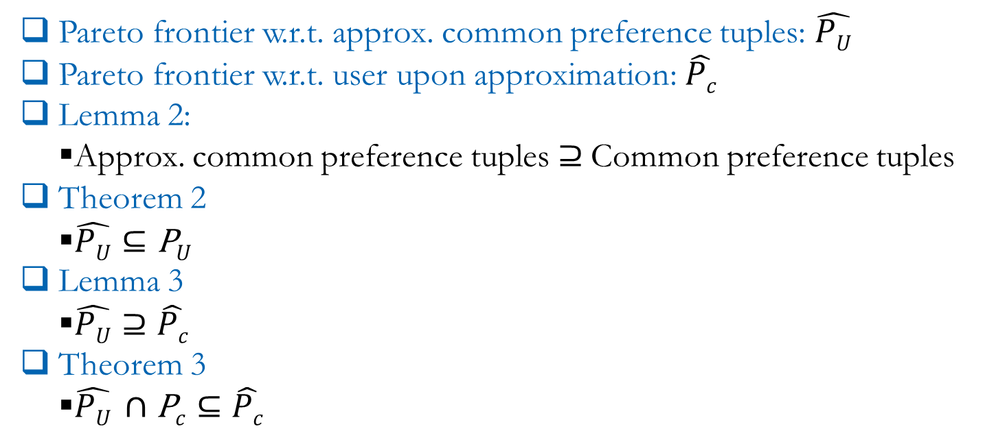

Properties of Approx. Common Preference Tuples
Pareto frontier w.r.t. approx. common preference tuples: $\hat{PU}$
Pareto frontier w.r.t. user upon approximation: $\hat{Pc}$
Lemma 2:
Approx. common preference tuples $⊇$Common preference tuples
Theorem 2
$\hat{PU}⊆\text{P}U$
Lemma 3
$\hat{PU}⊇\hat{Pc}$
Theorem 3
$\hat{PU} ∩\text{P}c⊆\hat{Pc}$
O
$\text{P}U$
$$\hat{PU}$$
$\hat{P}c$
$$\text{P}c$$
35
System idir.uta.edu/claimbuster
System idir.uta.edu/claimbuster
Notes:
Here are some properties of approx. common preference tuples. Let me elaborate these through Venn diagram. We have already seen the relation between Pareto frontier w.r.t common preference tuples and the corresponding users.
This ellipse represents the Pareto frontier w.r.t. approx. common preference tuples. We can see that the outer circle includes this ellipse. That means, the Pareto frontier with regard to approximate common preference tuples is a subset of the Pareto frontier for common preference tuples.
This smaller ellipse shows the Pareto frontier w.r.t. c upon approximation.

Slide 36
Similarity Function
Percentage of preference tuples
36
System idir.uta.edu/claimbuster
System idir.uta.edu/claimbuster
Notes:
We define additional similarity functions that are compatible with approximate common preference tuples. Since an approximate common preference tuple might remain absent in some users, we incorporate the percentage of each preference tuple in a cluster.
For this cluster, 75% users prefer Toshiba to Lenovo.
I request you to read our paper for the detail.

Slide 37
Related Works
Conventional preference query (Kießling VLDB 2002)
Pareto frontier w.r.t. individual users, separately
Our solution---
Share computation across multiple users
37
System idir.uta.edu/claimbuster
System idir.uta.edu/claimbuster
Notes:
Let’s come to the related works.
The conventional preference query is given preferences for individual users, computing the corresponding Pareto frontier, separately.
We share computation across multiple users.

Slide 38
Related Works
Mining favorable facets (Wong et al. SIGKDD 2007)
Minimum disqualifying condition
 | Minimum set of preferences to disqualify
o₁ | ((Samsung,Apple) ∧ (dual,single)) ∨ ((Toshiba,Apple) ∧ (quad,single))
o₂ | ((Apple,Samsung) ∧ (single,dual)) ∨ ((Toshiba,Samsung) ∧ (quad,dual))
o₃ | ((Apple,Toshiba) ∧ (single,quad)) ∨ ((Samsung,Toshiba) ∧ (dual,quad))
 | brand | CPU
o₁ | Apple | single
o₂ | Samsung | dual
o₃ | Toshiba | quad
Our solution---
Compatible with continuously arriving objects
38
System idir.uta.edu/claimbuster
System idir.uta.edu/claimbuster
Notes:
Wong et al. worked on mining favorable facets.
Given a set of objects, the goal is finding minimum set of preferences that disqualify an object in Pareto-optimality. In case of any update in the object set, the minimum disqualifying condition must be recomputed.
Certainly, this is not compatible with continuously arriving objects.

Slide 39
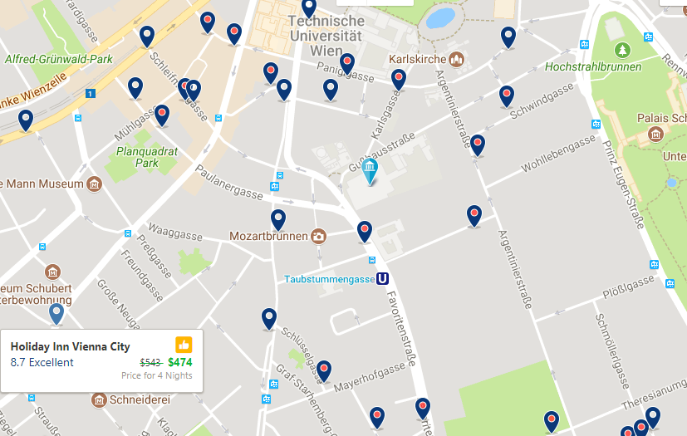
Related Works
 | Attribute | Order
Reverse skyline query (Dellis et al. VLDB 2007) | Numerical: price, distance | Total
Our solution | Categorical/numerical: brand, hotel/suite | Partial
39
System idir.uta.edu/claimbuster
System idir.uta.edu/claimbuster
Notes:
Dellis et al. worked on reverse skyline query.
Given a hotel, they aim at finding target customers based on price and distance from customers while these numerical attributes are totally ordered.
We further consider preferences over categorical attributes such as brands and whether customers prefer suite or hotel.

Slide 40
Experiment by Simulation
Movie Dataset
12,749 movies: joined Netflix dataset with data from IMDB
1000 users
4 attributes: actor, director, genre, writer
Publication Dataset
17,598 publications: ACM Digital Library
1000 users
4 attributes: affiliation, author, conference, and keyword
40
System idir.uta.edu/claimbuster
System idir.uta.edu/claimbuster
Notes:
Let’s come to our experiment.
Currently, there exists no publicly available dataset that captures real users’ preferences as strict partial orders. We thus simulated such partial orders using two real datasets of users’ preferences.
We joined Netflix dataset with the data from IMDB.
We collected publication records from ACM digital Library.
Suppose a user watched 10 movies of Tom Hanks and the average rating given by her is 4.5/5. She also watched 8 movies of Tom cruise and the average rating given by her is 4/5. We can assume that she prefers Tom Hanks to Tom Cruise. If there are two movies of these actors release simultaneously, she is more likely to watch the movie of Tom Hanks rather than Tom Cruise.

Slide 41
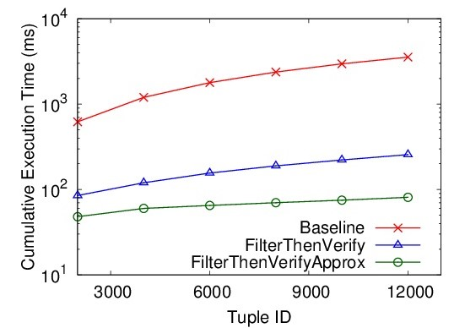
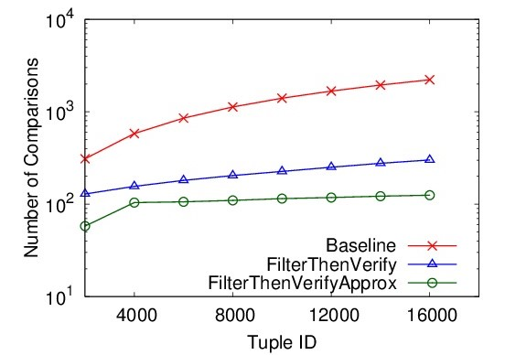
Performance of FilterThenVerify/FilterThenVerifyApprox
Movie Dataset
Publication Dataset
Baseline < FilterThenVerify/FilterThenVerifyApprox
Fewer comparisons due to filtering
FilterThenVerify < FilterThenVerifyApprox
Approx. allows more sharing
41
System idir.uta.edu/claimbuster
System idir.uta.edu/claimbuster
Notes:
These figures compare per-tuple execution time.
This red line represents Baseline. These two lines are for FilterThenVerify and FilterThenVerify upon approximation.
We can see that our solutions outperformed the baseline by orders of magnitude because of less number of comparisons due to filtering.
FilterThenVerifyApprox outperformed FilterThenVerify as approximation allows more sharing across users.

Slide 42
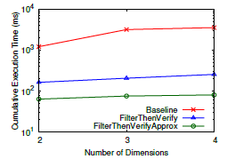
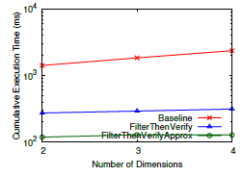
Performance of FilterThenVerify/FilterThenVerifyApprox
Movie Dataset
Publication Dataset
Execution time increases with d
High d=>large Pareto frontiers=>more comparisons
42
System idir.uta.edu/claimbuster
System idir.uta.edu/claimbuster
Notes:
These figures compare execution time with the increase of dimensionality.
We can see that the execution time of all these methods increased super-linearly by dimensionality as more attributes allow larger Pare frontiers and thereby, upon the arrival of a new object, it needs to compete with more existing objects.

Slide 43
Efficacy of FilterThenVerifyApprox
Dataset | h = 0.70 |  |  | h = 0.55
 | Precision | Recall | F-measure | Precision | Recall | F-measure
Movie | 100 | 95.43 | 97.67 | 99.99 | 90.46 | 94.99
Publication | 100 | 96.59 | 98.27 | 100 | 95.13 | 97.51
Recall decreases with h
Small h=>large clusters=>high false negatives
Stable precision
Few false negatives=>fewer false positives
43
System idir.uta.edu/claimbuster
System idir.uta.edu/claimbuster
Notes:
This table describes the efficacy of FilterThenVerifyApprox.
Here, h is the similarity score.
We observe that recall decreases with h. Smaller h results in larger clusters and potentially more approximate common preference tuples for each cluster. Those approximate common preference tuples cause false negatives.
We can also see the that precision remains stable with h. An object o appears as a false positive if every single Pareto-optimal object that dominates o becomes a false negative. As the number of false negatives are already low, an object is very unlikely to become a false positive.

Slide 44
Conclusion
Efficient algorithm to find target users
Novel problem of clustering partial orders
44
System idir.uta.edu/claimbuster
System idir.uta.edu/claimbuster
Notes:
Now this is our system architecture.
We presented efficient algorithm to find target users of a given object. At the same time, we studied a novel problem of clustering strict partial orders.

Slide 45
THANK YOU!

